Slide 1
Practices that Promote a Pedagogy of Play
© 2023 President and Fellows of Harvard College. This work is licensed under Creative Commons Attribution-NonCommercial-ShareAlike 4.0 International. Funded by the LEGO Foundation, this resource was developed by Pedagogy of Play at Project Zero.
Notes:
Fostering a school where playful learning thrives requires a holistic approach – cultivating a whole school culture around learning through play. Helpful to have more specific set of practices...Based on the findings from our research in the 3 contexts you’ve heard about, we’ve developed a set of 5 practices that educators can use to promote a pedagogy of play.

Slide 2
Gameplan
Revisit key concepts in the course so far through a playful activity
Learn about the Pedagogy of Play practices and explore examples of these from classrooms
Make connections between the local learning standards in your context and the PoP practices
Try out planning learning experiences using the practices for inspiration

Slide 3
Madlib:
Why do we need a Pedagogy of Play? We spent the first 1.____. 2. ____ of the course answering this question. We 3.________ at frameworks and theories to understand 4._______, talked about equity and play, and began advocating for 5.________. We also were introduced to playful participatory research.
We then examined the question “What does 6.________through play look and feel like in different cultural contexts?” We studied indicators and examples of 7.______learning from different cultural contexts. We studied technology, remote 8._________ and play, and discussed how play is for all in a session on inclusive playful 9.__________.
Notes:
Show this AFTER you have harvested ideas from the students for the blanks, and insert their words aloud as you read through the paragraph.

Slide 4
Madlib – a playful way to revisit our learning so far
Why do we need a Pedagogy of Play? We spent the first four weeks of the course answering this question. We looked at frameworks and theories to understand play, talked about equity and play, and began advocating for play. We also were introduced to playful participatory research.
We then examined the question “What does learning through play look and feel like in different cultural contexts?” We studied indicators and examples of playful learning from different cultural contexts. We studied technology, remote learning and play, and discussed how play is
Notes:
Then show this – the “real” text. And appreciate the laughs from the silly version the students put together.
Then use this to spark a discussion of what the students have learned so far

Slide 5
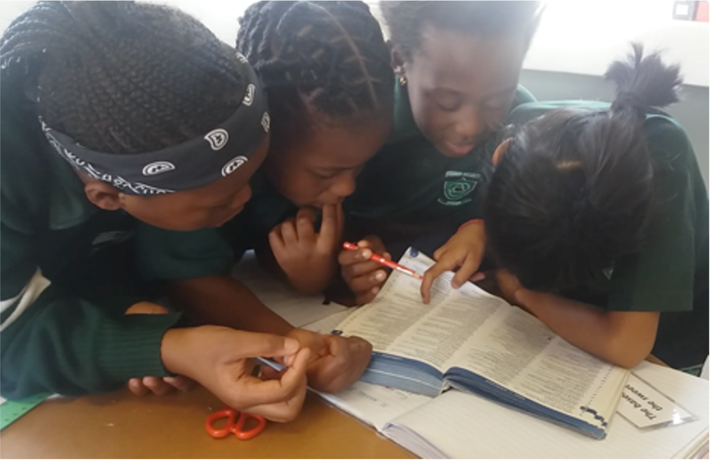
Pedagogy of Play
Empower Learners To Lead Their Own Learning
Notes:
Overview of practices – for each of these, briefly explain what the practice is about.
Taking playful learning seriously means tipping the balance of responsibility for learning toward learners. Look for opportunities to turn important aspects of learning over to students and support them in this process. Following students’ lead requires flexibility and a willingness to modify teaching plans.

Slide 6
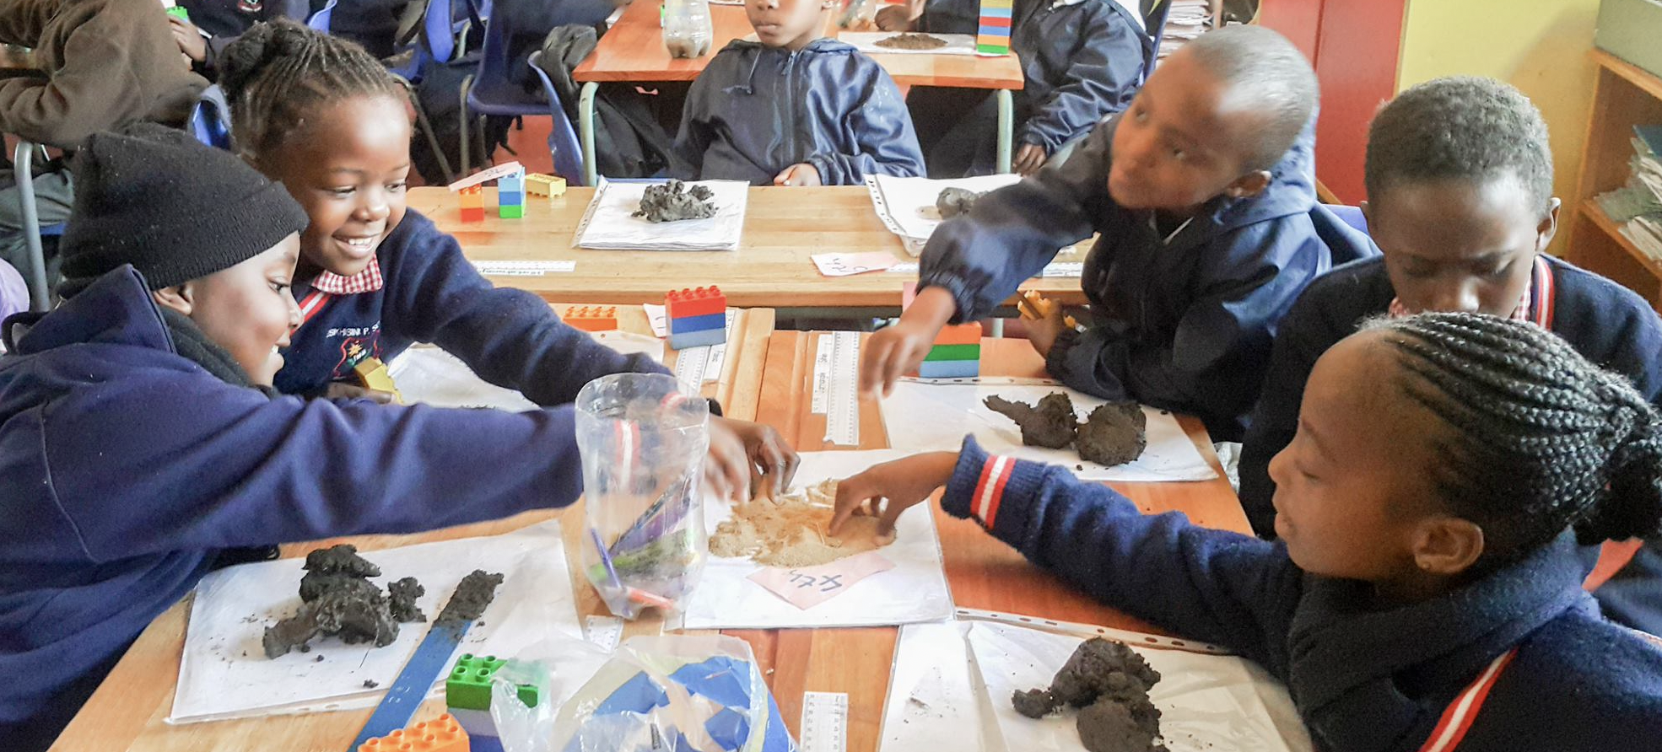
Pedagogy of Play
Build a Culture of Collaborative Learning
Notes:
Feelings of playful learning are often activated and sustained by being part of a group. Playful learning is enhanced when players exchange, build on, or disagree with each other’s ideas. Set up the conditions for collaborative learning so that students have opportunities to learn with and from each other.

Slide 7
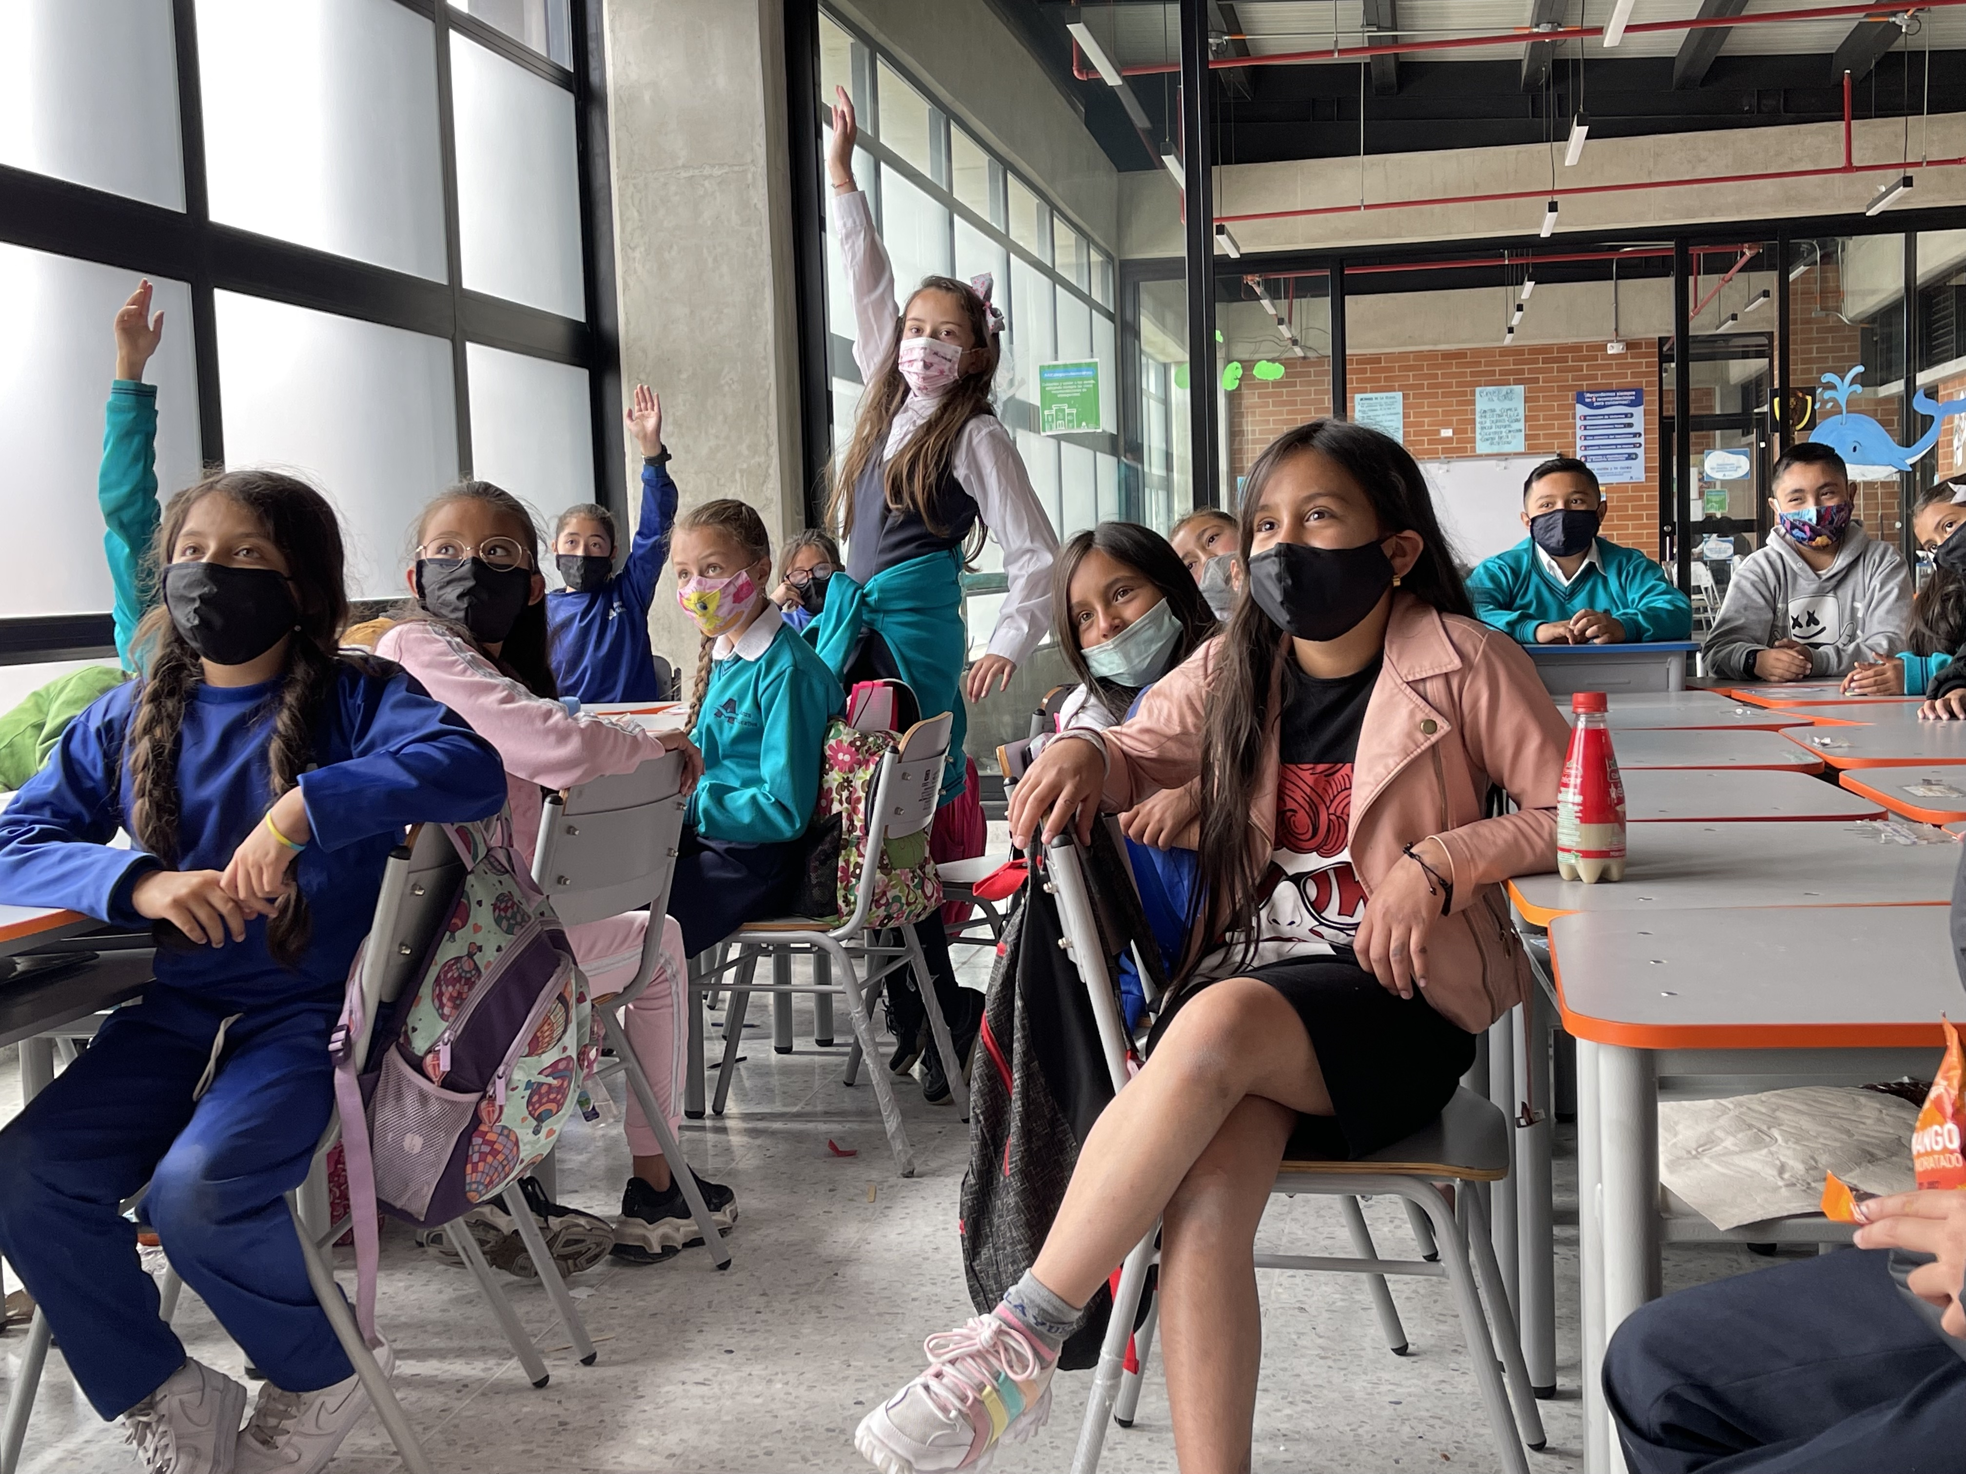
Pedagogy of Play
Promote Experimentation and Risk-Taking
Notes:
A playful classroom provides a safe space for learners to experiment with materials and ideas, as they take risks, try new things, and work through frustration. Nurturing a culture of exploration helps children develop creative thinking skills and provides opportunities for them to see risk-taking and learning from failure as important parts of the learning process.

Slide 8
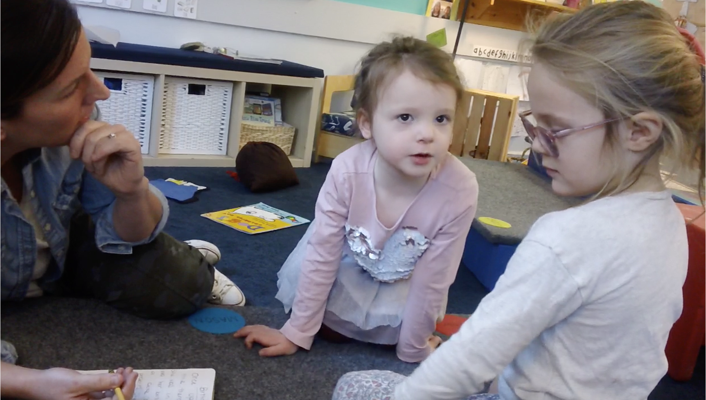
Pedagogy of Play
Encourage Imaginative Thinking
Notes:
Engaging the imagination brings learners into the what if space of learning, where students explore, create, invent, generate new ideas, and take different perspectives. Learning can deepen when students move between different ways of expressing themselves.

Slide 9
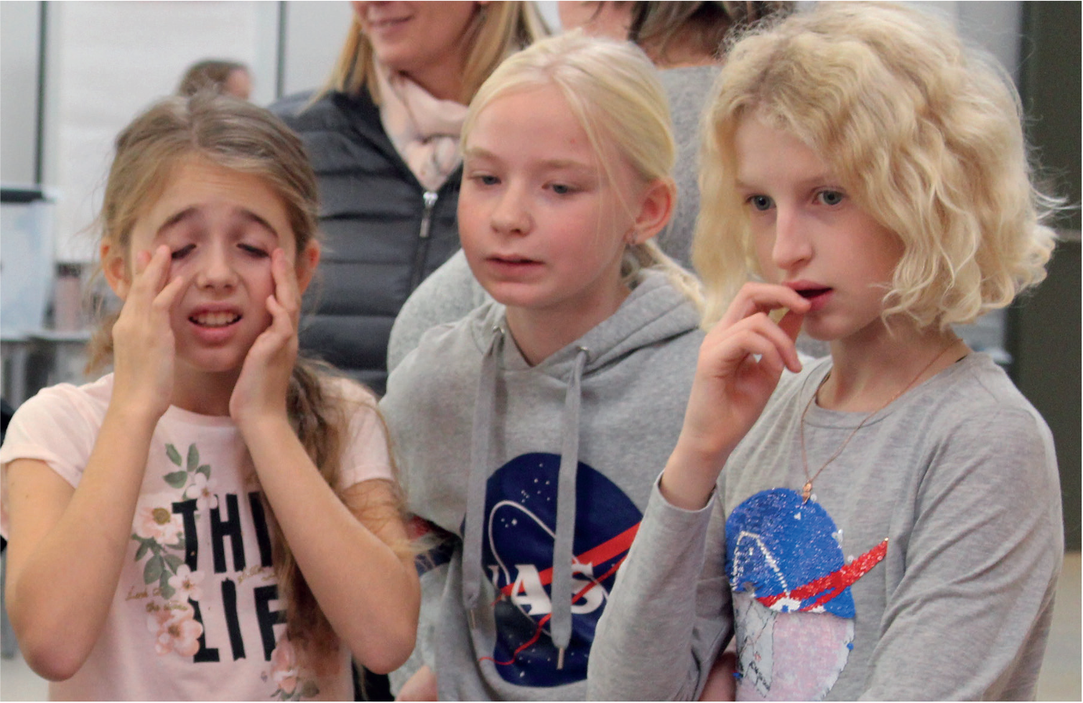
Pedagogy of Play
Welcome all Emotions Generated Through Play
Notes:
Learning through play can involve a range of emotions, including feelings of enjoyment, satisfaction, and ownership, as well as frustration and even anger. It is important to welcome and value all of these emotions when designing and facilitating learning experiences. Because what is playful for one learner isn’t necessarily playful for all learners, strive to provide more than one way for students to learn playfully.

Slide 10
Does a Fact Have to be True and the Tic Toc
Nova Pioneer Ormede
Johannesburg, South Africa
Notes:
We are going to use a story from a school in South Africa to illustrate these practices in action. For this story I’d like to ask for a few volunteers to play the role of the teacher and her students. Let me read out the roles and as I do, please signal with a real or virtual hand raise if you’d be willing to read your part off the powerpoint slides. So for all you aspiring actors…
Tadiswa
Abdullah
Mbali
Ntando
Firdous
And I’ll be the narrator
“Does a Fact Have to be True”, and the Tic Toc
Context:
This story takes place in a Grade 5 at classroom at Nova Pioneer Ormande, an independent school in Johannesburg. Most of the students at the school come from the surrounding historically Indian neighborhood and nearby Soweto, the township where Nelson Mandela and Desmond Tutu lived and today is home to a growing black middle class.
Firdous Ismil is the teacher. She has 31 learners whom she teaches maths, social studies and language arts.

Slide 11
Chapter One A Writers Workshop on Information Texts
Notes:
This story takes place during a Writers workshop lesson 3 months into the school year). The lesson was part of a study of writing genres that was focusing on informational texts.

Slide 12
Learning Goals
Reading: Gain familiarity with informational texts—to be able to locate information confidently and efficiently
Writing: Create non-fiction texts that provide information in a clear and engaging way
Notes:
Firdous’s learning goals for this lesson were connected to year-long objectives for reading that involved gaining familiarity with non-fiction texts—to be able to locate information confidently and efficiently—and writing—to create non-fiction texts that provide information in a clear and engaging way.
There were two parts to lesson. First, the class considered what they knew about informational texts. Firdous then gave them a provocation meant to engage their imaginations in serve of their writing skills by asking them to create their own creature. Work on creating an informational text about the creature continued during the next writing workshop.

Slide 13
Chapter Two Does a fact have to be true?
Notes:
In previous lessons Firdous provides her learners informational texts such as ‘How to build an airplane’ and ‘all about bears’ to consider features of the genre.

Slide 14
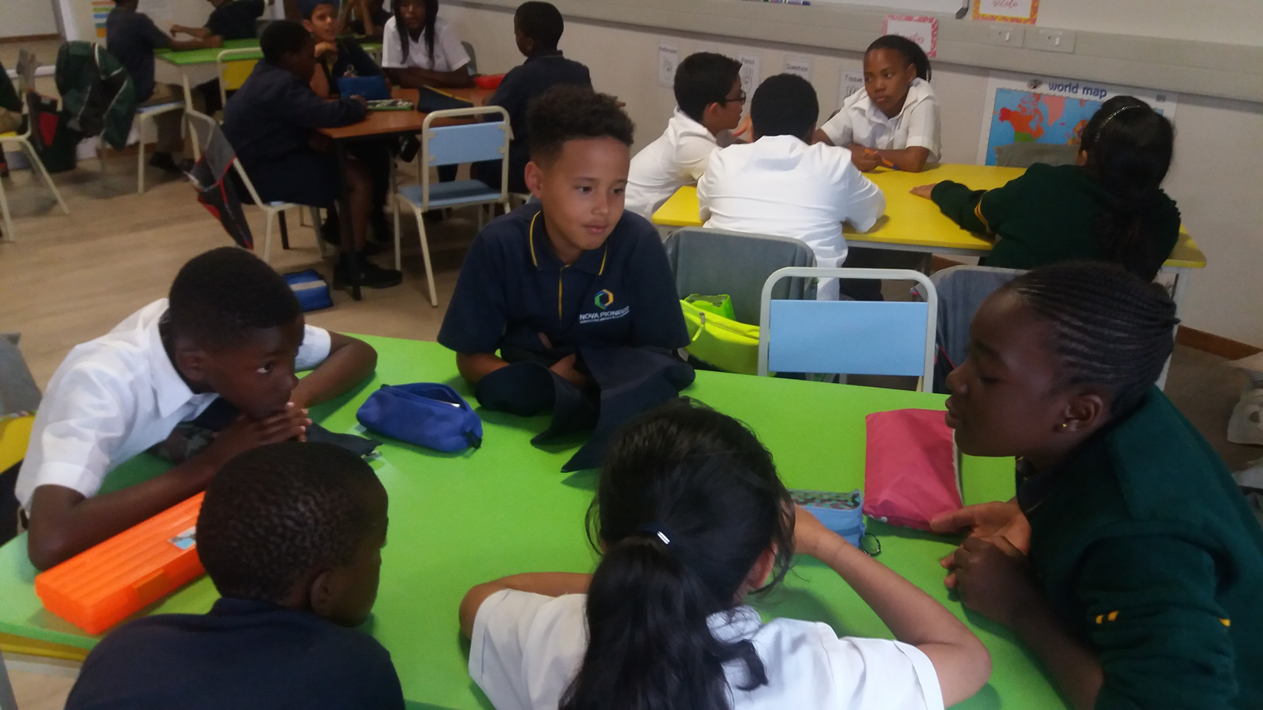
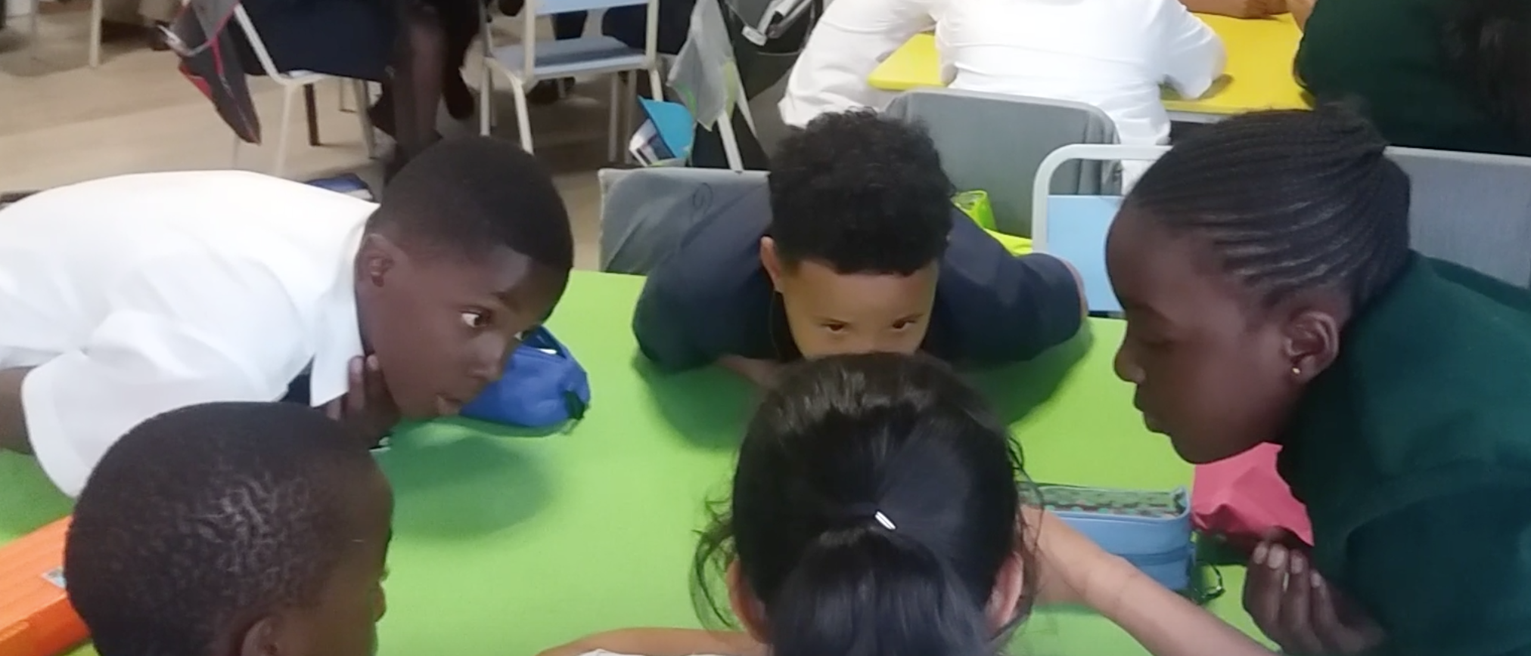
Notes:
On this day, to relaunch the conversation, Firdous asks her students to discuss what they had learned about such writings in their table groups. The huddle together for a few minutes, sharing what they remember with one another.
Firdous then invites learners to share with the whole group their definitions of informational texts. She calls on one learner, who, after sharing, calls on another learner and so on.

Slide 15
Students definitions of informational texts
Mbali: Gives you more information on the subject.
Ntando: A step by step description.
Tadiswa: About something or someone.
Notes:
Definitions include:
Mbali “Gives you more information on the subject”,
Ntando “a step by step description.”
Tadiswa adds they are “about something or someone”
An expectation of such discussions is that learners give examples to support their statements.

Slide 16
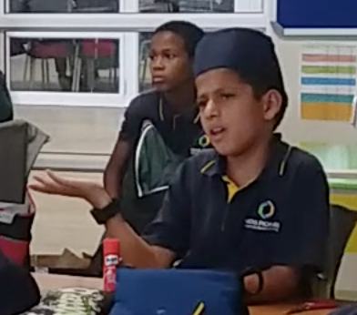
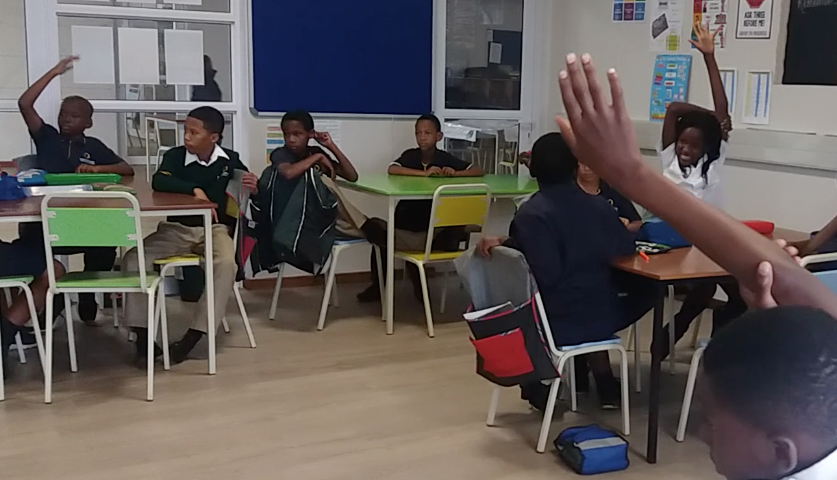
Mbali : Fiction does not give correct information
Abdullah: It is a fact that Spiderman can spin webs from his wrists. Even though Spiderman is not real, it is still a fact that he fights crimes.
Notes:
An interesting argument arises when Abdullah’s example is about Spiderman. According to Abdullah, (click) it is a fact that spider man can spin webs from his wrists. Even though spider man is not real, it is still a fact that he fights crimes.
(click) Mbali disagrees. (click) She argues that this is not a fact because spider man is fictional and fiction does not give ‘correct information’. Abdullah remains convinced that spider man spinning spider webs is a fact. (click) Lots of hands pop up and a spirited debate ensues.

Slide 17
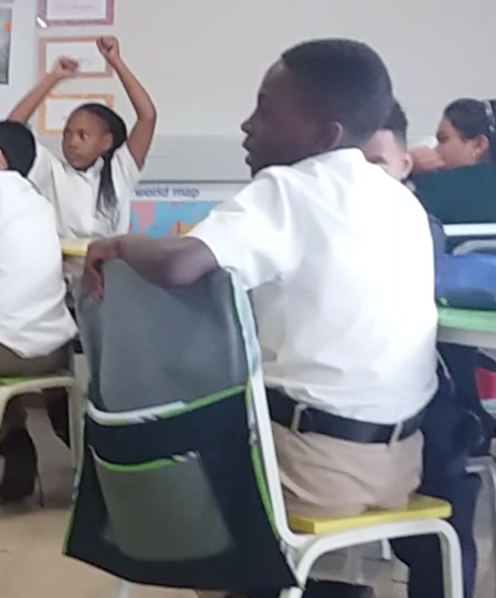
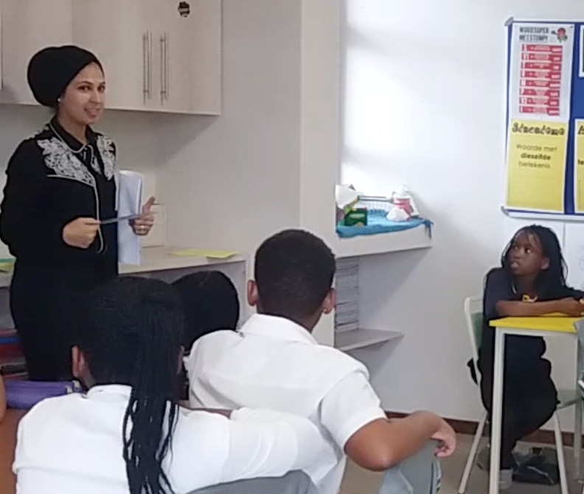
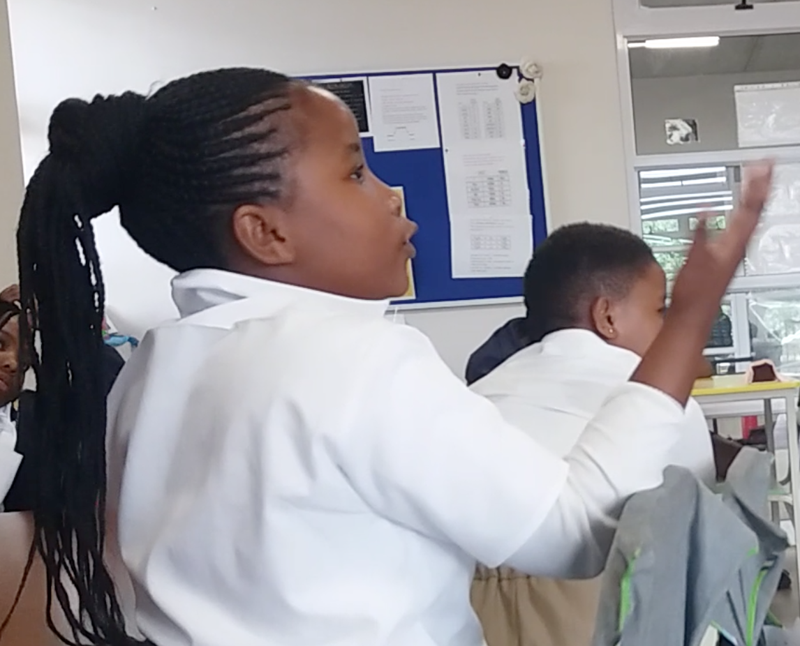
Ntando: There cannot be an informational text about Spiderman because it’s a story from the movies and even his web is not real”.
Firdous: Do all facts have to be true to life ?
Ntando: Facts have to be true.
Notes:
Ntando --hat there cannot be an informational text about Spiderman because ‘it’s a story from the movies and even his web is not real”
Firdous joins the conversation. (click) She asks:“Do all facts have to be true to life?”
(click) Ntando answers that facts have to be true.

Slide 18
Follow up questions
If a fact is something that actually exists, is fear a fact?
If a fact is something known to be true, what about religious beliefs?
Notes:
The conversation sends learners to the dictionary to look up “fact”. Armed with their definitions other questions arose. If a fact is something that actually exists, Is fear fact? If the definition of fact is things known to be true, what about religious beliefs? These are known to be true for some, but not others.

Slide 19
Chapter Three Making it more complicated
Notes:
That Abdullah gave the Spiderman example, provoking such a debate, was wonderful serendipity. she can normalize the reality that learning involves moments of confusion, uncertainty and ambiguity and use the conversation as a Segway to the next part of the lesson.
The lesson continues:

Slide 20
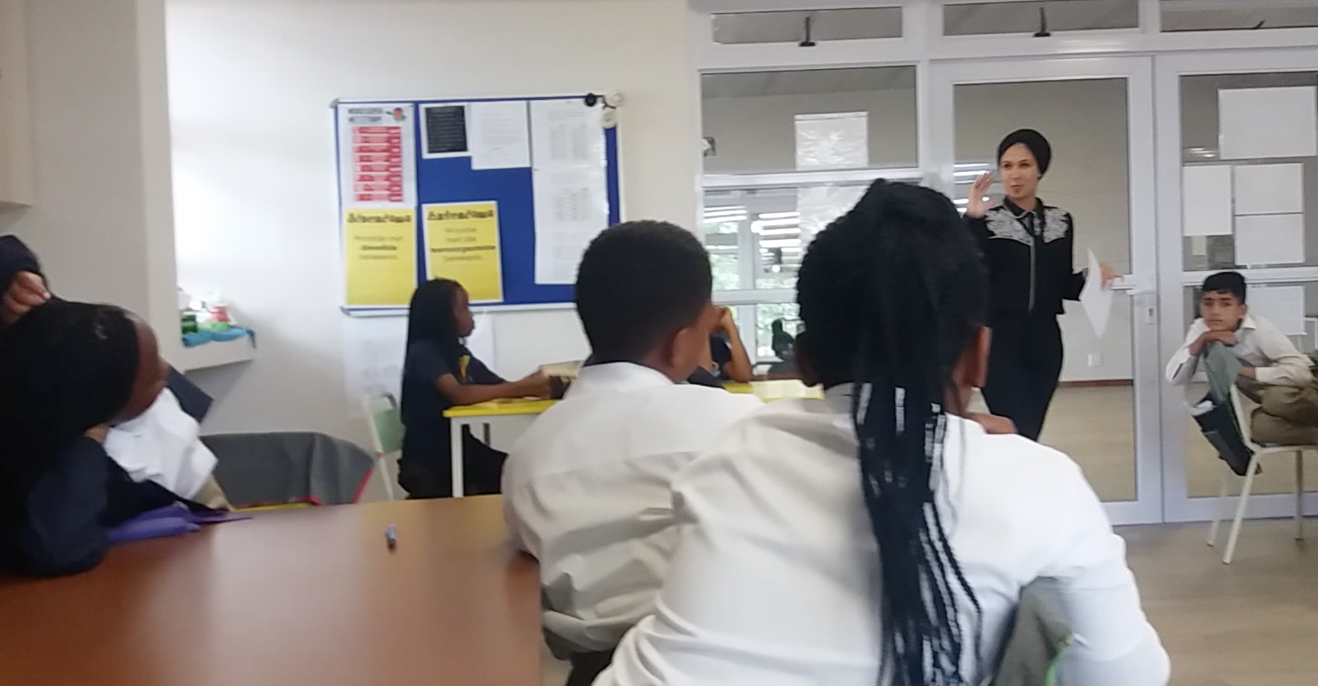
Firdous: I’m loving what is coming out of this conversation…
A lot of you seem a little confused. Some of you are now unsure. You were sure and now you are unsure. And I’m going to make it a little more complicated.
Notes:
Firdous tell her students that “I loving what is coming out of this conversation.” She adds, “A lot of you seem a little confused. Some of you are now unsure. You were sure and now you are unsure. And I’m going to make it a little more complicated.” A few learners grown, and smiling Firdous explains the assignment she has for the class.

Slide 21
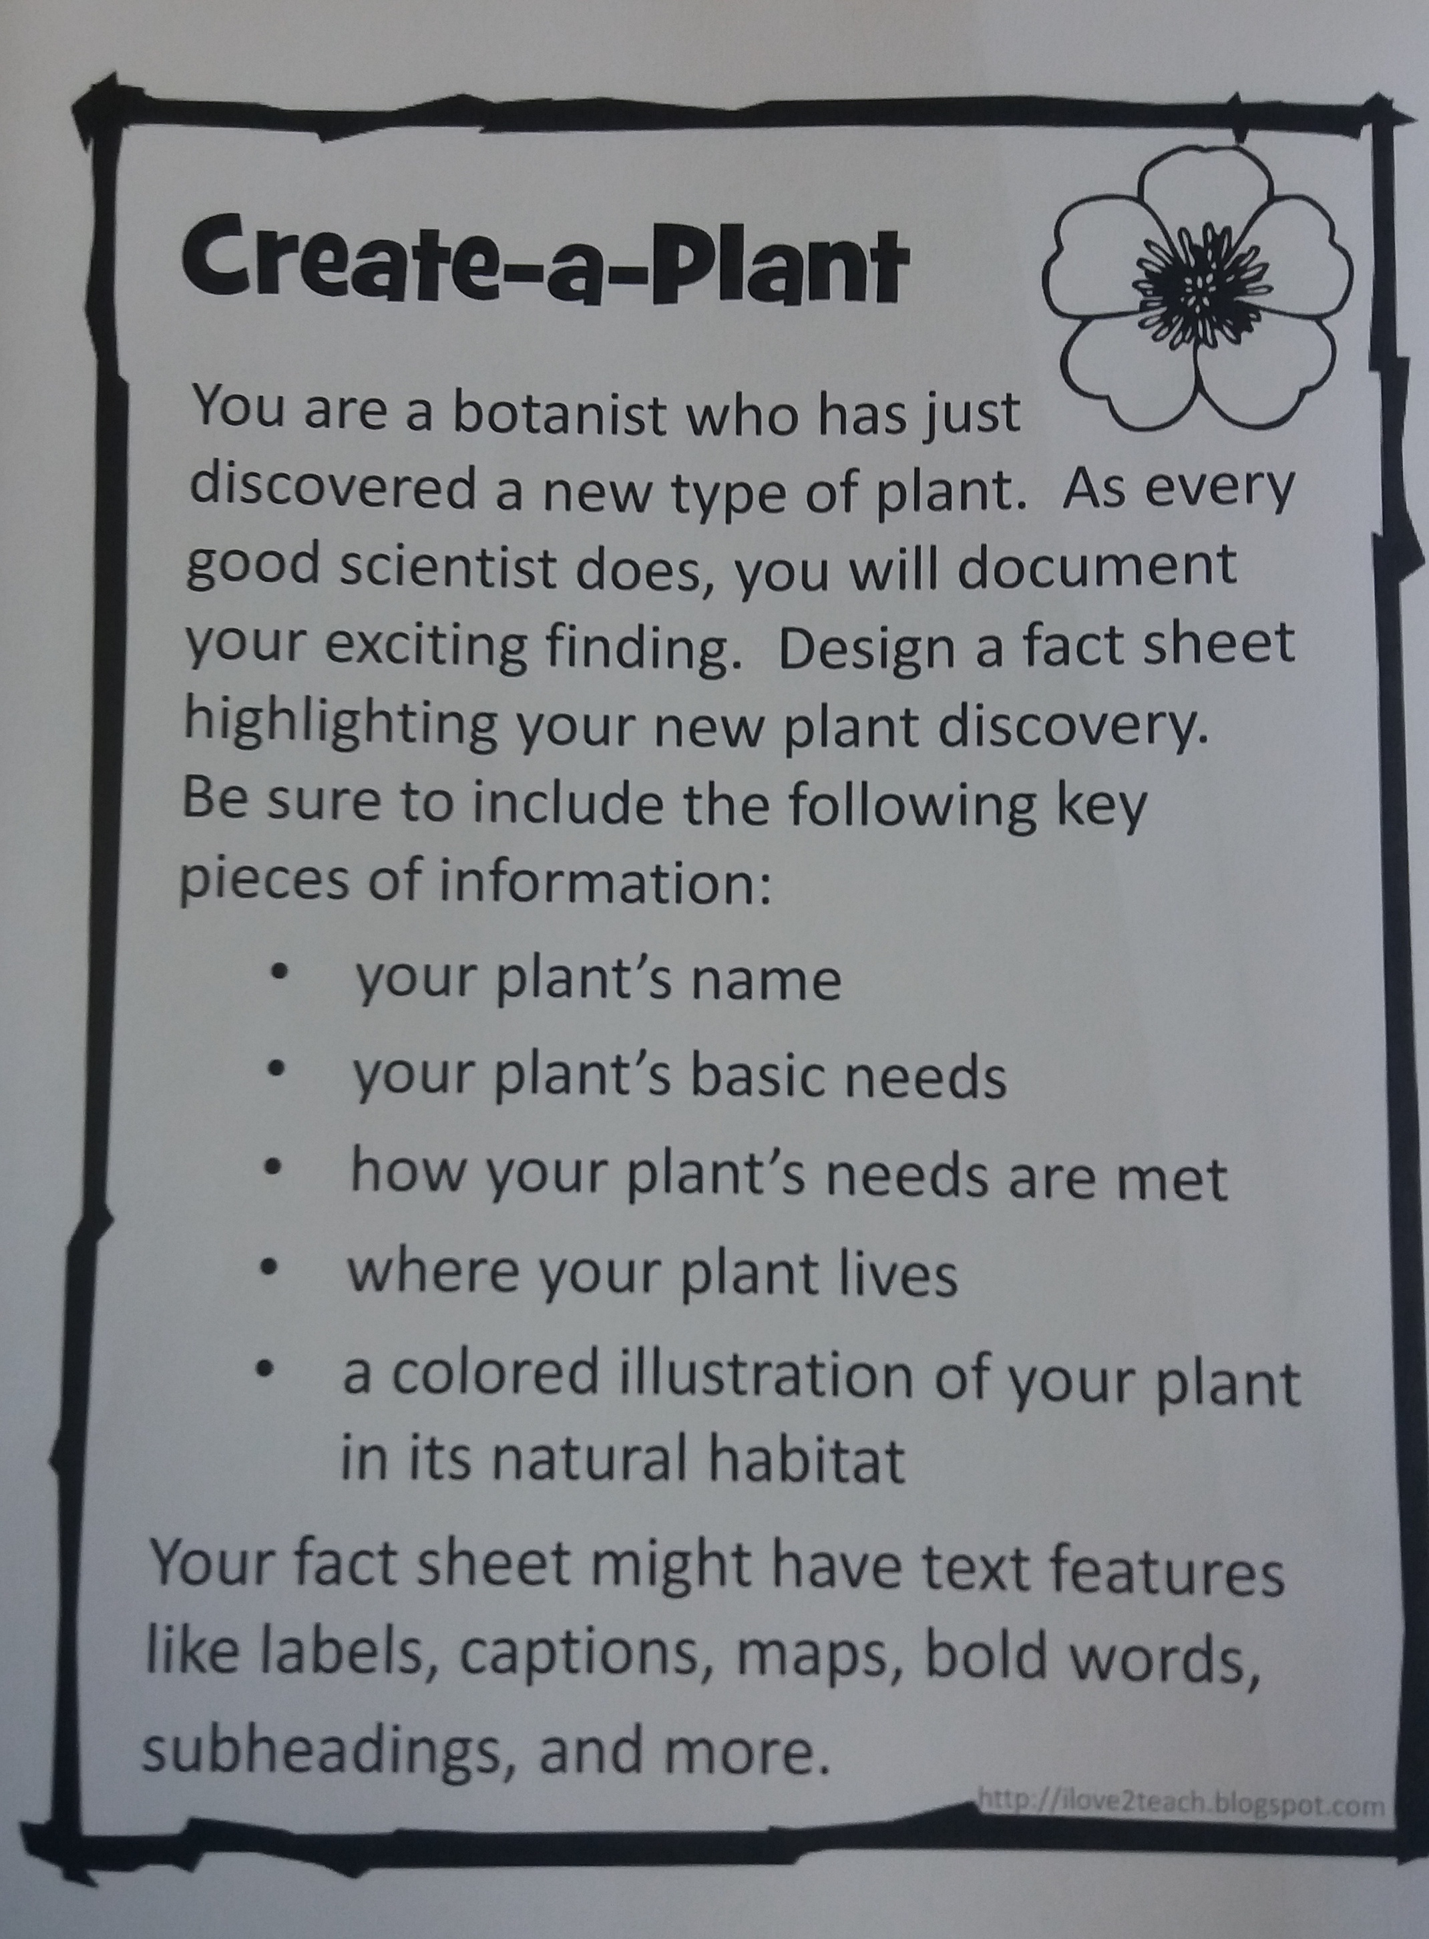
Notes:
She hands out two papers to each table for them to read over and make sense of the assignment. The papers explain learners have the choice of either creating their own plant or animal and name the features of the plant or animal.

Slide 22
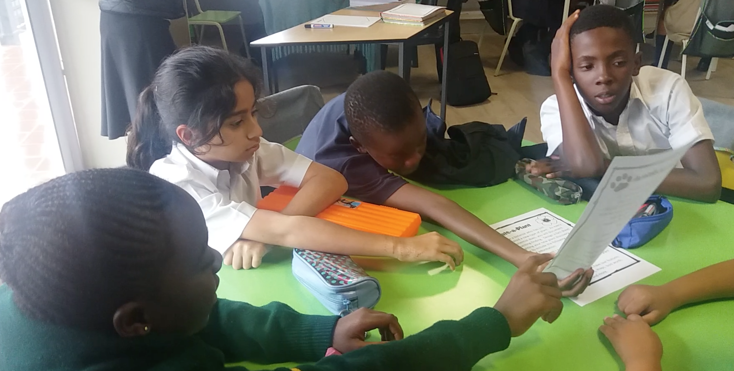
Notes:
The learners discuss the assignment for a few minutes and then come together as a whole group to ask questions to clarify the assignment. Firdous then tells them they can pretend that,

Slide 23
Firdous: You are the scientist; it’s your discovery, You can draw or write the facts first. It’s okay to think of real-life plants and animals to get inspiration. It’s okay to look at one another’s work because this enables you to share ideas and to give each other feedback. However, make the creation your own.
Notes:
‘You are the scientist; it’s your discovery, You can draw or write the facts first. It’s okay to think of real-life plants and animals to get inspiration. It’s okay to look at one another’s work because this enables you to share ideas and to give each other feedback. However, make the creation your own.”

Slide 24
Chapter Four Creating a tic toc
Notes:
Learners get to work. Some girls create purple flowers that live in the desert. Boys imagine animals that combine the features of lizards and dragons, and lions that fly.

Slide 25
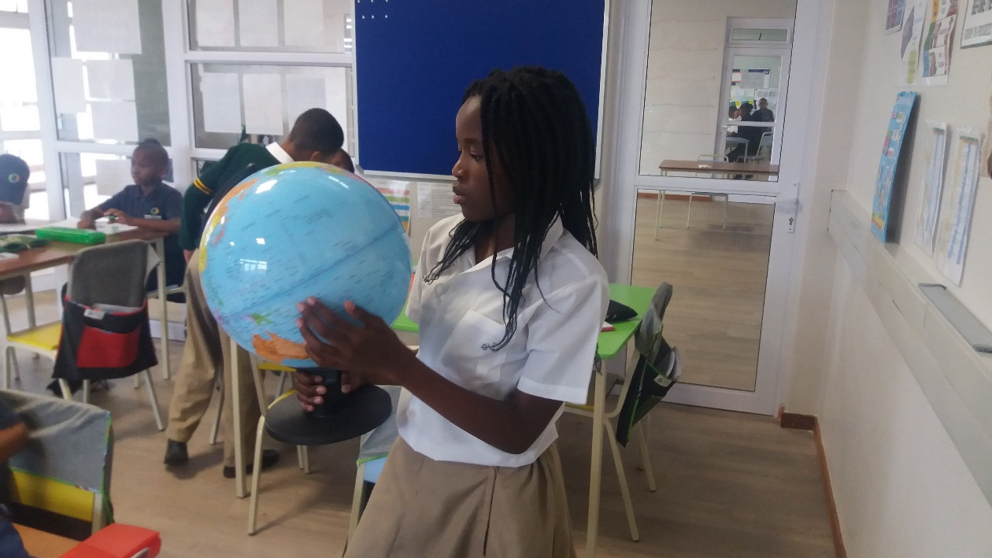
Tadiswa : Ma’am, may I please use the globe? I want to see where my animal will be from.
Notes:
Tadiswa has a question: ‘Ma’am may I please use the globe? I want to see where my animal will be from.’ Firdous agrees and Tadiswa fetches the globe from the book shelf.

Slide 26
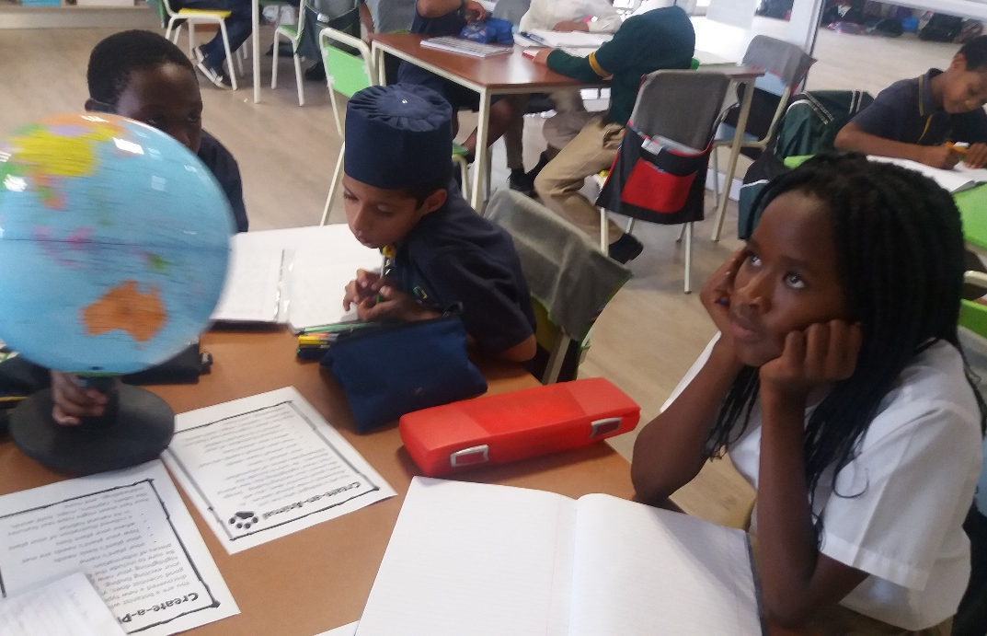
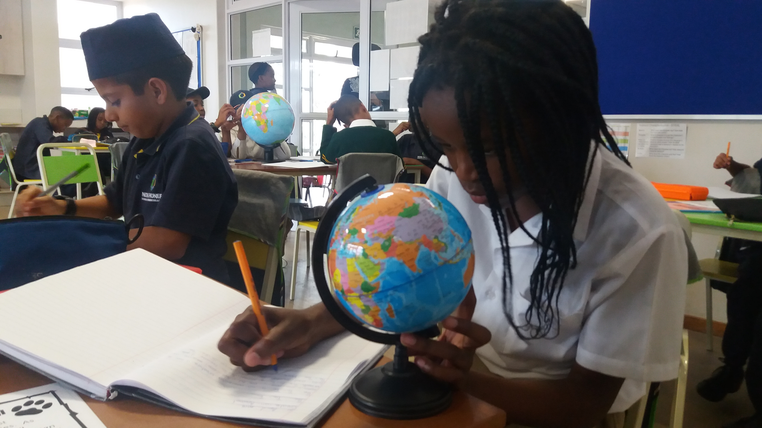
Notes:
She takes the globe to her table studies it. She spins it around slowly, looking at it intently.
After five minutes starts writing. Asked what she is thinking she answers:

Slide 27
Tadiswa: I don’t want it to come from South Africa. It’s always the same place. I want to go somewhere like maybe somewhere where nobody has ever been to. Or somewhere that is very rare…I just want to find something that is really exciting… It will stand out. It will be a little different. It will have that little touch.
Notes:
I don’t want it to come from South Africa. It’s always the same place. I want to go somewhere like maybe somewhere where nobody has ever been to…I just want to find something that is really exciting… It will stand out. It will be a little different. It will have that little touch.

Slide 28
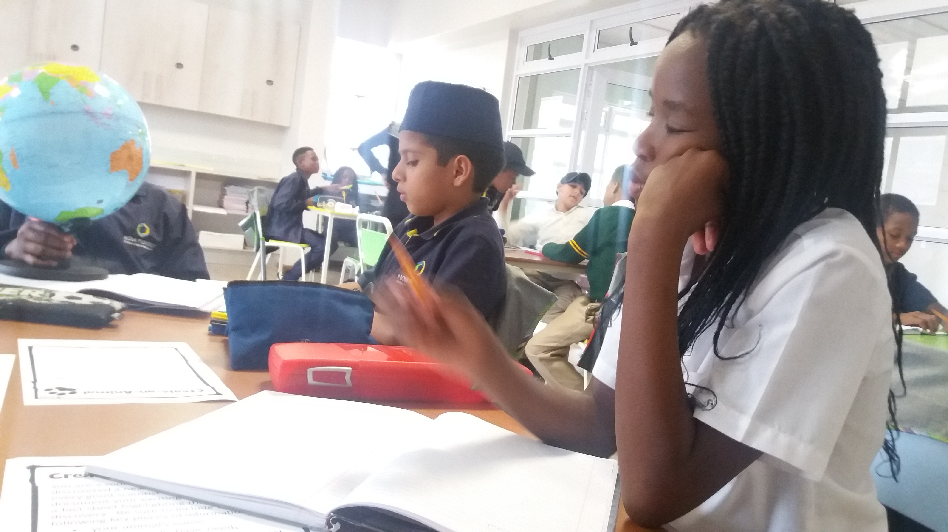
Notes:
Abdullah asks if Tadiswa will share the globe with him so he can find a home for his animal. She gladly hands it over.
She writes more and explains about where her animal lives:

Slide 29
Tadiswa: I’m thinking in the ocean because I want it to be a sea animal. Maybe it can also go out of the water like a dolphin if it needs air. I want it to go on land as well. So, maybe it will have like a little island where it can breathe. It can feed off the coconuts and it can also go into the water to find fish.
I am excited too! I am excited about what it will look like when I am done. I think I want to make it look really cute. But when it opens the mouth it looks like a killer shark!
Notes:
Read from this slide

Slide 30
Chapter Five Meet the Tic Toc
Notes:
Tadiswa spends 20 minutes working on her creature. The next day there is a 45 minute writing workshop period where she builds on the previous day’s work. She writes, shares what she has written with Abdullah for feedback, and writes some more. In the end, she has created a Tic Toc. This is what a Tic Toc looks like

Slide 31
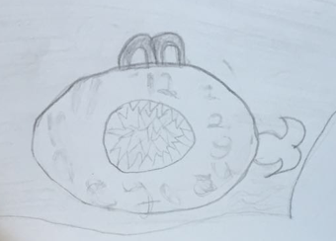
Tadiswa: The Tic-Toc is an amazing creature it has 2 eyes, one nose, one tail, two small arms and one mouth. The Tic-Toc is named Tic-Toc because it looks and sounds like clock going tic-toc. Tic-Toc lives in Kermadec Island (N.Z.). My animal needs 12 hours of being in the water and 12 hours of being on land. The Tic-Toc also feeds on prawns and baby fish. On land it feeds on coconuts and sand. Tic-Toc can only be 600km away from the island so that it cannot die.
Notes:
And this is T’s description about her animal:
(read on slide)

Slide 32
Chapter Six Everything is fun about it
Notes:
How did Tadiswa feel about this lesson? She explains:

Slide 33
Tadiswa: [It was fun] that we get to do this. Well, everything is fun about it because like we get to invent something that is different. We get to create. It’s like an art session or like a general knowledge session. It’s just like really exciting.
Notes:
Read from slide

Slide 34
Which practices did you see in this example?
Empower learners to lead their own learning
Build a culture of collaborative learning
Promote experimentation and risk-taking
Encourage imaginative thinking
Welcome all emotions generated through play
Notes:
Ask student to discuss as a class or in small groups

Slide 35
Learning Standards
Add a link or screenshot here to the local learning standards appropriate to your students

Slide 36
In many contexts, learning standards outline WHAT learners are supposed to master, but don’t dictate HOW the content needs to be taught. This is where the PoP practices can be useful – to guide planning playful learning experiences that address the standards.

Slide 37
Planning Playful Learning Experiences with the PoP Practices
Consider a learning context, a learning standard, and choose a practice or strategy that could lead to a playful learning experience in a playful way.
Notes:
Use the google slides linked in the Instructor Guide for this activity or create paper copies students can work with in the classroom.

Slide 38
Context: Second Grade Learning Goal: Reading Literature - Acknowledge differences in the points of view of characters
Pick 1-2 strategies from the PoP Practices booklet that you could you use to teach this content in a playful way
Talk through ideas with your group members.
Use materials in your play kit to represent yourself teaching this content in a playful way to.
Upload a photo of your representation to this slide (you can delete this text) and be ready to talk about it with the class.
Notes:
If you can’t access the Google slides for this activity, here’s an example of what they are like. Each slide has a different context and learning goal, tailored to the learners in your class (learning goals appropriate to your context, age of learners and content areas relevant)

Slide 39
Looking Playfully at Documentation Protocol
Listening: The presenting teacher names their question and gives context about the documentation they are sharing (2 min)
Looking: Look carefully at the documentation for a few minutes (2-3 min)
Clarifying: Presenter answers short, fact-based questions from the group (2 min)
Noticing and Wondering: a round of “I notice” (just saying what you see/hear in the documentation without judgement), and then ”I wonder” statements. The presenter listens and is silent (4 min)
Pretending: Take on roles, act out a scenario from the documentation (2-3 min)
Noticing/Wondering again: Did the playing help you notice anything new? (2 min)
Inspiring: Repeat the presenter’s question. What could the presenter try as next steps in their teaching? Or share ideas of what to document next. (5 min)
Closing: The presenter has the last word to share their take-aways/questions. (2 min)
Notes:
This is a protocol to use for sharing documentation in the inquiry groups. Will use this for the rest of the semester

Slide 40
Additional slides follow… if you want to dig more into one particular practice (or save this for session 10)

Slide 41
Empower learners to lead their own learning
Get to know your learners
Co-construct rules
Say yes to students spontaneous ideas
Reflect on learning with learners
Involve learners in decision-making
Notes:
So what does it mean to empower learners to lead their own learning?
Taking playful learning seriously means tipping the balance of responsibility for learning toward learners. You might look for opportunities to turn important aspects of learning over to students, so they can have some choice in what they're learning, how they're learning, whom they're learning with, even where and when they're learning. Following students' lead requires a bit of flexibility, and a willingness to modify teaching plans. It also involves making sure that the learning that is happening is meaningful to the students.
CLICK
get to know your learners – what are their questions? What are their curiosities? What do they like to do at home? Get to know your learners so you can make learning meaningful to them and so you can design experiences around their interests, skills, and questions
CLICK
2. co-construct rules – where are there opportunities for learners to have input into classroom norms and rules? Where can they shape expectations?
CLICK
3. say yes to students' spontaneous ideas. Of course you need to balance the learning objectives and facilitate play with a purpose, but often students drive learning in ways that moves thinking forward...follow their lead, try saying yes and honoring their ideas
CLICK
4. reflect on learning with learners...this does a few things to empower learners to lead their learning:
• makes visible the learning that has taken place
• strengthens learners’ understanding of how to learn
• leads to deeper exploration of ideas and content
• When learners better understand how they are learning, they become equipped to co-construct or lead the learning process.
And finally:
CLICK
5. involve learners in decision-making about
• the content
• the learning process
• the product of learning
• the set-up of the classroom space
• where to sit
• with whom to partner
• how to greet each other
So that’s an overview of what this practice means

Slide 42
Encourage imaginative thinking
Share stories to engage and enhance learning
Ask questions that invite curiosity
Use role play and pretend scenarios
Provide materials and experiences that engage the senses and the body
Notes:
Engaging the imagination brings learners into the what if space of learning. This is a place where students explore, where they create, where they invent and generate new ideas, put divergent ideas together, and where they explore and take different perspectives. Moving between different ways and different modalities of exporing content and materials and ideas can deepen learning and make learning engaging, playful, interesting, and challening. So what are some teaching moves that might support this kind of thinking?
CLICK
Share stories to engage and enhance learning
Telling stories and constructing narratives are a central way people connect to, explore, and understand ideas. Stories can be captivating and actively engaging. So a teaching move is to encourage learners -- regardless of age -- to listen to and tell stories as a way to explore content and share personal experiences. This is not just for early childhood.
CLICK
Be mindful about the kinds of questions you might ask --
Think about questions you might ask that invite imaginative and divergent thinking. Questions with multiple answers (or maybe with no definitive answer at all) are invitations to play with ideas. For instance, rather than asking students to design a car, ask them to design a way they can get from home to school. Such questions open up opportunities for further learning, that don't set boundaries around ideas.
CLICK
Use role play and pretend scenarios
Pretend scenarios can engage learners – again of all ages - during an individual lesson and throughout units of inquiry. Role play allows learners to explore ideas and issues from different perspectives – thinking about stepping into other peoples shoes. You might ask students to demonstrate what they know through role play and pretend scenarios – and in fact this can put some students at ease and be a valuable assessment strategy.
CLICK
Provide materials and experiences that engage the senses and the body
This is about minds on and hands on thinking. Tinkering and maker-centered learning provide opportunities for exploring the properties of materials and the designed world, problem solving, and messing around with ideas. Think about what kinds of tools and materials you could offer that inspire inquiry, inventiveness, and creative thinking. It might be cardboard boxes, paints, rocks, and other found and natural materials; it might be material more catered to a physics lesson or exploration of electricity or water – materials that engage the senses and offer learners the opportunity to play with ideas.
So that's the practice we'll be playing with today...I'm going to turn it over to Ben to share an illustration of what this can look like in action.

